Slide 1

Tailwind Sales Analysis
Final Project of Microsoft Course: Deploy and Maintain Power BI Assets and Capstone Project.

Slide 2
Data Source
Data Files downloaded from the course resourses.
In this there are three Excel files which are imported in power BI. And some DAX created tables like date table ( Calender Table) and Exchange data Etc.

Slide 3
Calculations:
Calculated Tables:
1. Calender Table
CalendarTable =
ADDCOLUMNS(
CALENDAR(DATE(2020, 1, 1), DATE(2023, 12, 31)),
"Year", YEAR([Date]),
"Month Number", MONTH([Date]),
"Month", FORMAT([Date], "MMMM"),
"Quarter", QUARTER([Date]),
"Weekday", WEEKDAY([Date]),
"Day", DAY([Date])
)
2. Sales In USD-
Sales in USD =
ADDCOLUMNS(
Sales,
"Country Name", RELATED(Countries[Country]),
"Exchange Rate", RELATED('Exchange Data'[ExchangeRate]),
"Exchange Currency", RELATED('Exchange Data'[Exchange Currency]),
"Gross Revenue USD", [Gross Revenue] * RELATED('Exchange Data'[ExchangeRate]),
"Net Revenue USD", [Net Revenue] * RELATED('Exchange Data'[ExchangeRate]),
"Total Tax USD", [Total Tax] * RELATED('Exchange Data'[ExchangeRate])
)

Slide 4
Calculated mesures:
1. Quarterly profit Margin-
Quarterly Profit Margin =
CALCULATE(
[Yearly Profit Margin],
DATESQTD(CalendarTable[Date])
)
2. Median Sales-
Median Sales =
MEDIAN('Sales in USD'[Gross Revenue USD])
3. Yearly Profit Margin-
Yearly Profit Margin = DIVIDE(SUM('Sales'[Profit]), SUM('Sales'[Net Revenue]),0)
3. YTD Profit Margin-
YTD Profit Margin =
TOTALYTD([Yearly Profit Margin], CalendarTable[Date])

Slide 5
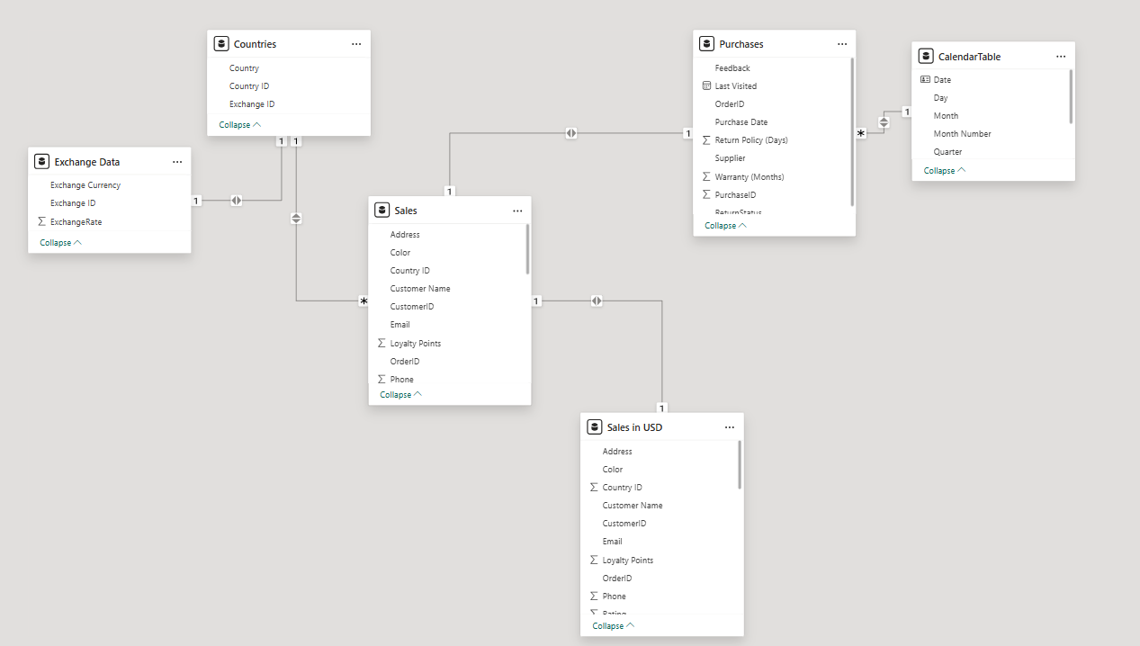
Data Model:

Slide 6
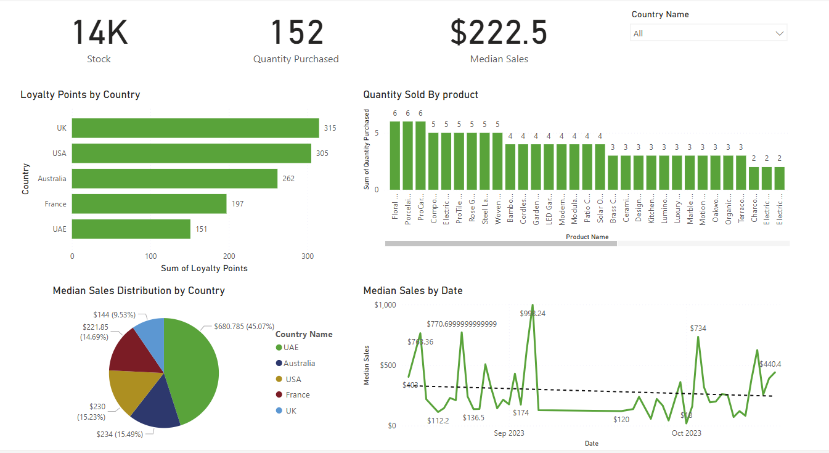
Dashboard:

Slide 7
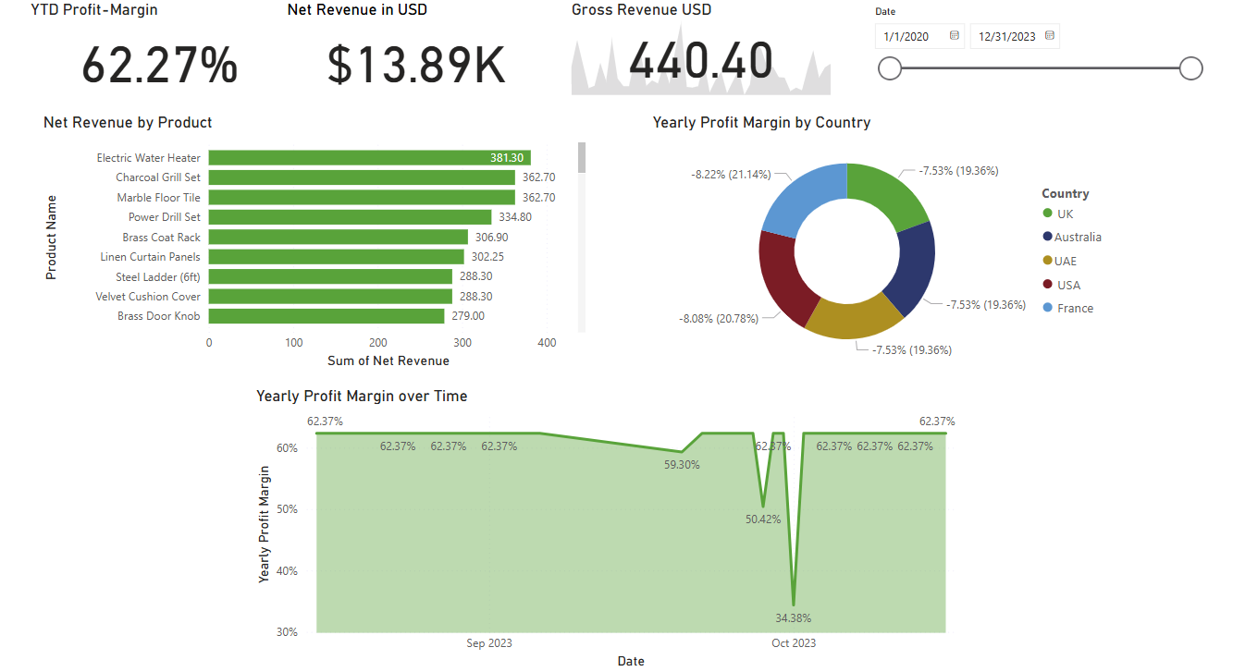
Dashboard:

Slide 8
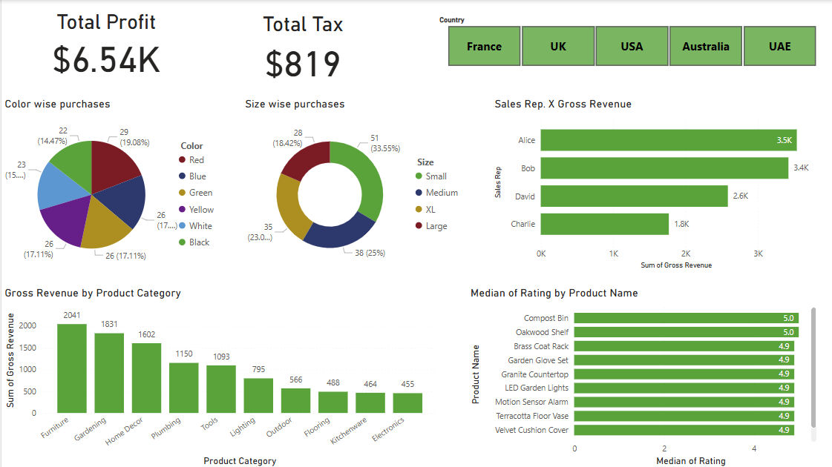
Dashboard:

